Slide 1
Leap case study team 3 – wealth wizards
Presented by:
Akanksha Raj
Deepthi N
Gyanadipta Mohanty
Vinayak Raj
Vishal Mishra

Slide 2

Wealth Wizards
"We conjure up the best solutions for your money"
Business goal:
To provide a range of portfolio management solutions that are customized, diversified, and effective for different segments of customers

Slide 3
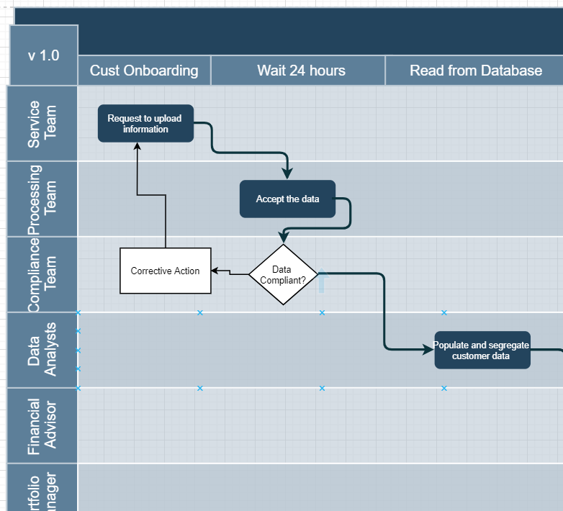
BUSINESS PROCESS FLOW

Slide 4
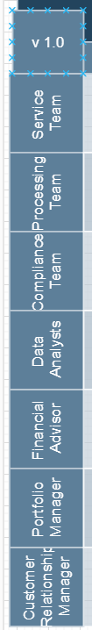
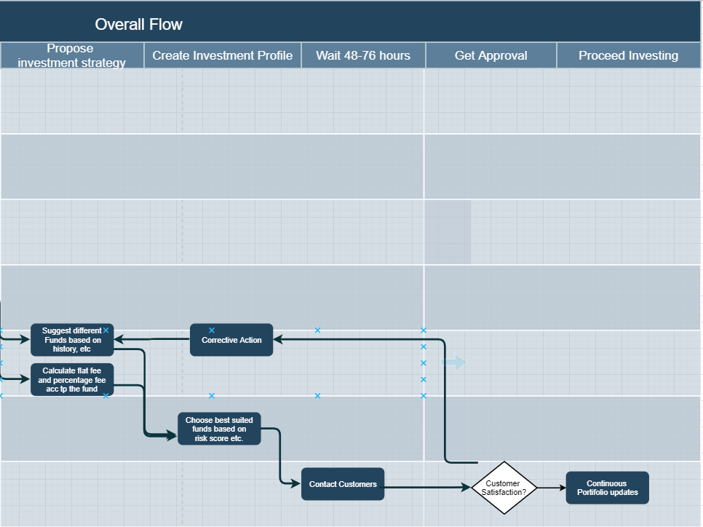
BUSINESS PROCESS FLOW

Slide 5
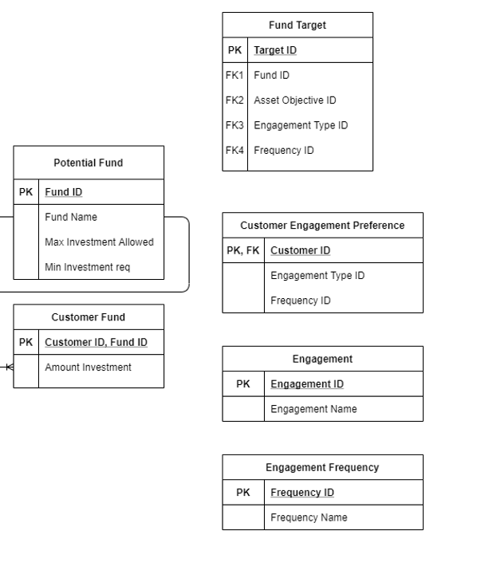
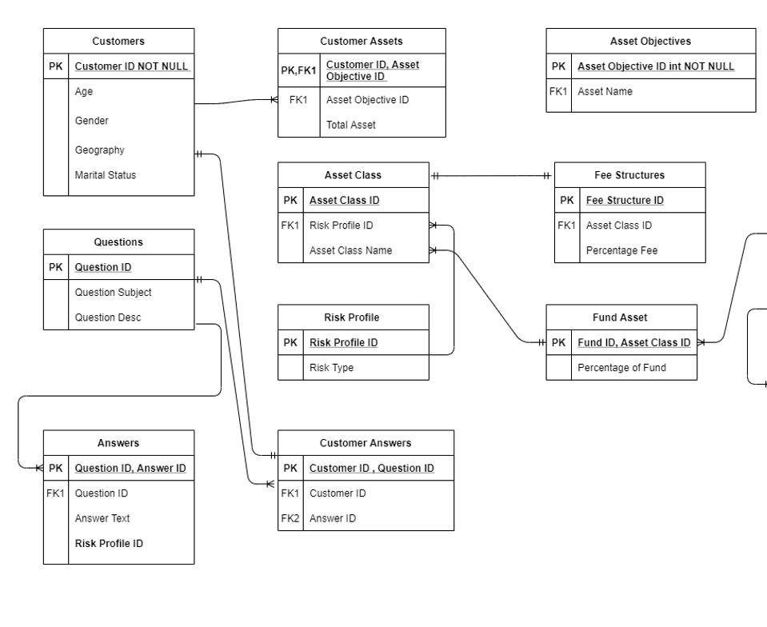
ER DIAGRAM

Slide 6
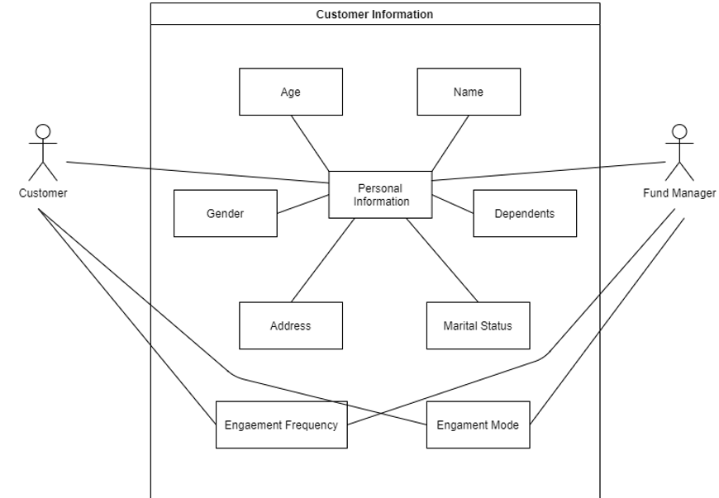
UML USE CASE

Slide 7
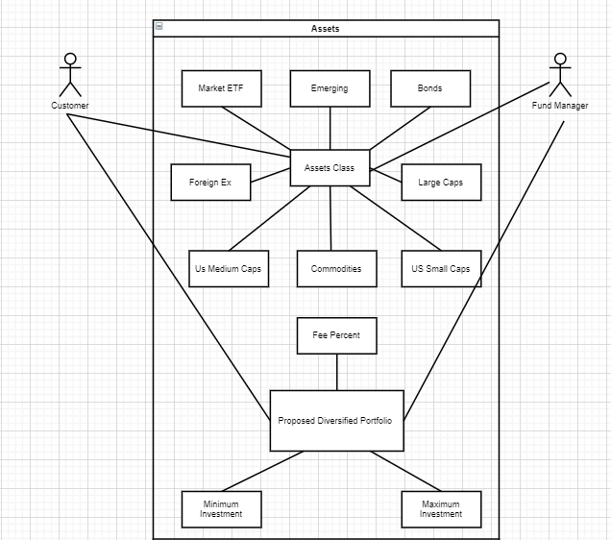
UML USE CASE

Slide 8
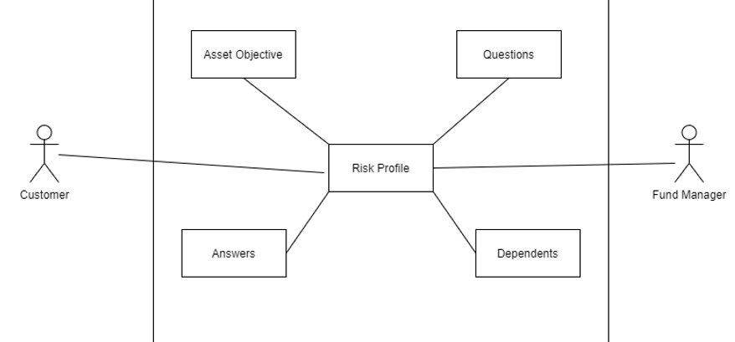
UML USE CASE
Answers

Slide 9


QUALITY CHECK OF DATA
PROFILING THE DATA
Identified relationships between the tables. Analyzed the data recorded in the excel.
Identified the tables that need to be filled by the end of the case study.
Checked for the quality of the data including but not limited to the data types, missing values etc.
DATA CLEANING
Dealt with undisclosed values in Gender, Marital Status.
In the answers table, the answer to every question was not recorded – changed strategy for the risk score analysis.
Notes:
In data cleaning – because of the unrecorded answers the graphs and risk score was getting skewed.

Slide 10
DATA ANALYSIS
Initially used Excel to do preliminary Data-Cleaning
Loading data into Python using Pandas
Converting each table into separate dataframes (splitting different sheets)
Pandas dataframe.info() function is used to get a concise summary of the dataframe.
Pandas describe() is used to view some basic statistical details like percentile, mean, std, etc. of a data frame or a series of numeric values.
We started analyzing data based on constraints mentioned like 2-4 risk tolerance, atleast 1000 customers in each segment.

Slide 11
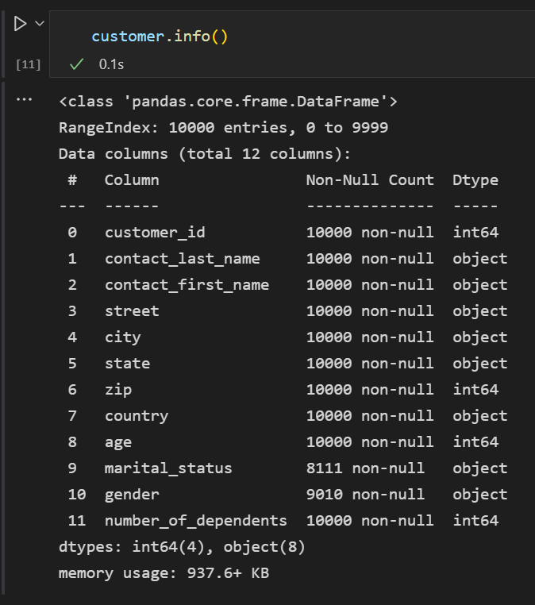
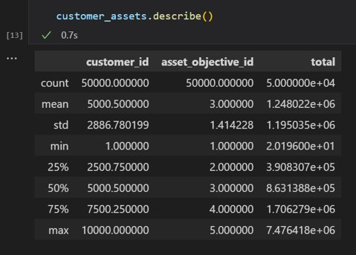

Slide 12
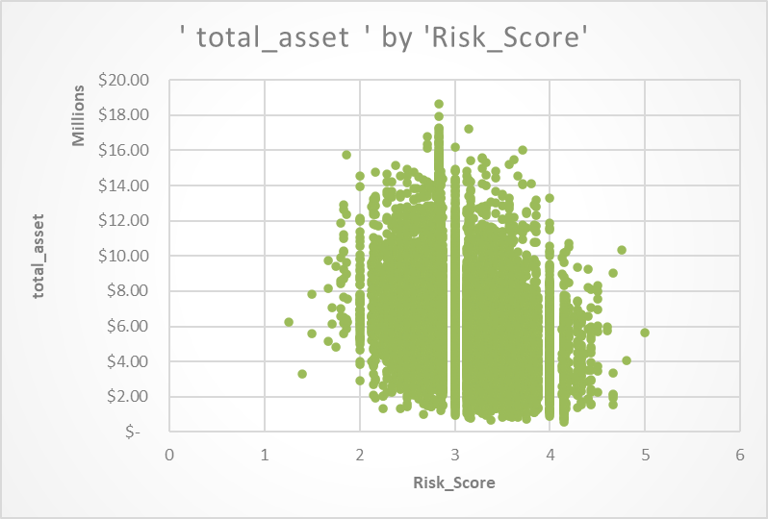
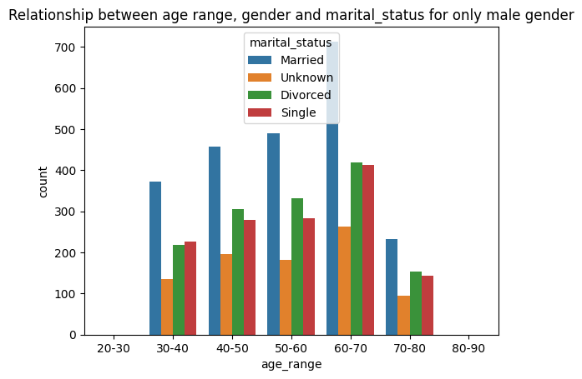
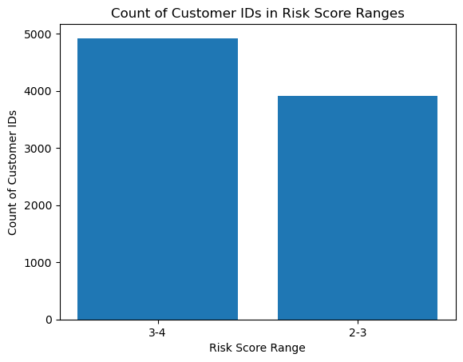
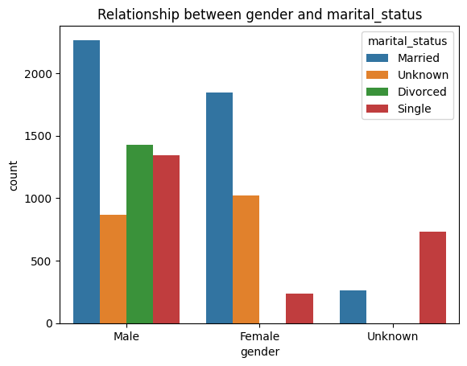

Slide 13
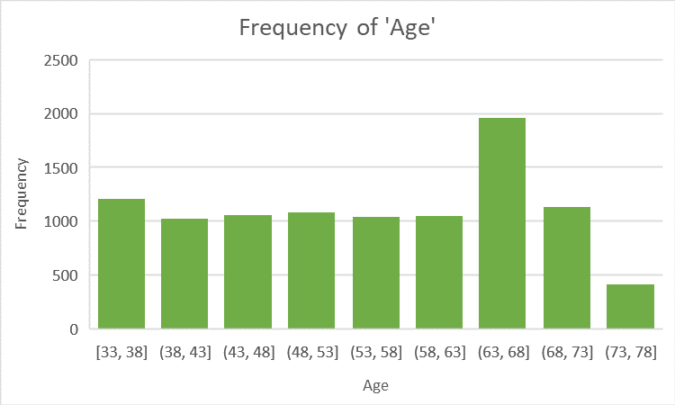
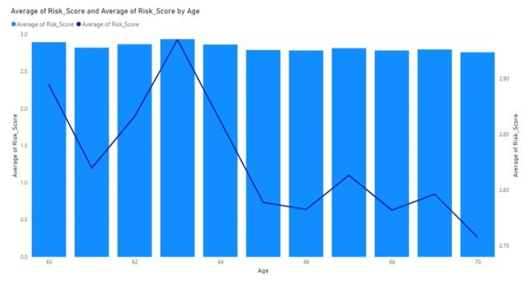
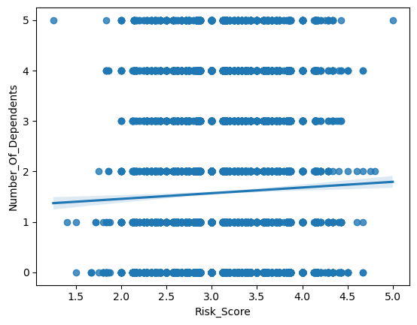
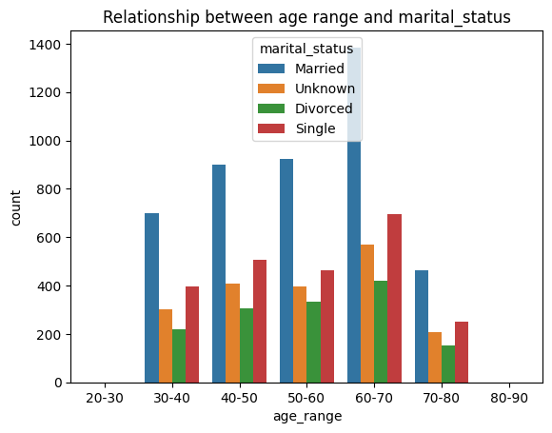

Slide 14
Customer Segmentation

Slide 15

Wealth Wizard's Retirement Oriented Segment
"Secure your future and your retirement ambitions with us"
Mission Statement:
To provide retirement solutions that are tailored to the needs and risk profiles of customers who have multiple dependents
Target Segment :
Asset Objective: Retirement
Number of Dependents: 3+
Medium Risk Takers
We chose this segment because we want to help customers who have retirement objectives and have to support multiple dependents.
We know that these customers have different challenges and opportunities than other customers who have retirement objectives but have fewer or no dependents.
We also know that these customers have different risk profiles than other customers who have retirement objectives but are either low or high risk takers.
We want to offer these customers solutions that can help them achieve their retirement goals while balancing their risk appetite and their family obligations.

Slide 16
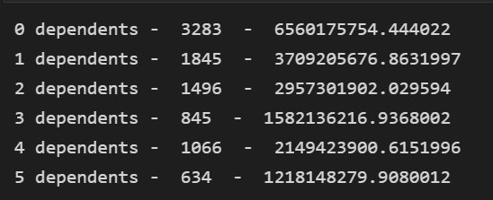

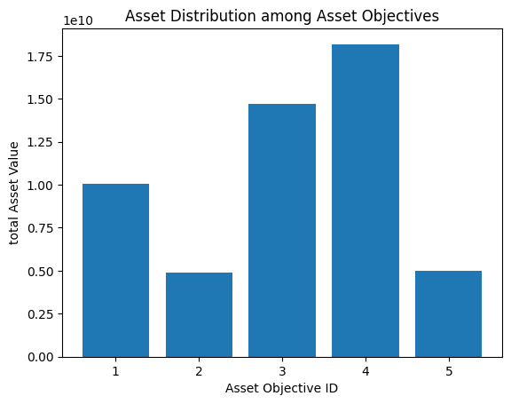
Statistician Wizard

Slide 17

Wealth Wizard's Golden Peace Segment
"We will let you enjoy your golden years with peace of mind as we value your happiness and well-being "
Mission Statement:
To provide post-retirement easy living solutions that are safe, stable, and suitable for customers who are into the old age group and are married.
Target Segment :
Marital Status: Married
Age Range: 60 – 70 years
Low Risk Takers
We chose this segment because we want to help customers who are in the old age group, are married, and are low risk takers.
We know that these customers have different needs and preferences than other customers who are in the old age group but are either single or high risk takers.
We want to offer these customers solutions that can help them enjoy their retirement years while preserving their capital and minimizing their losses.

Slide 18
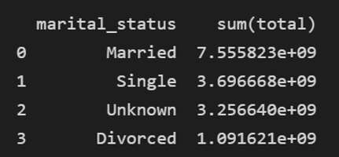
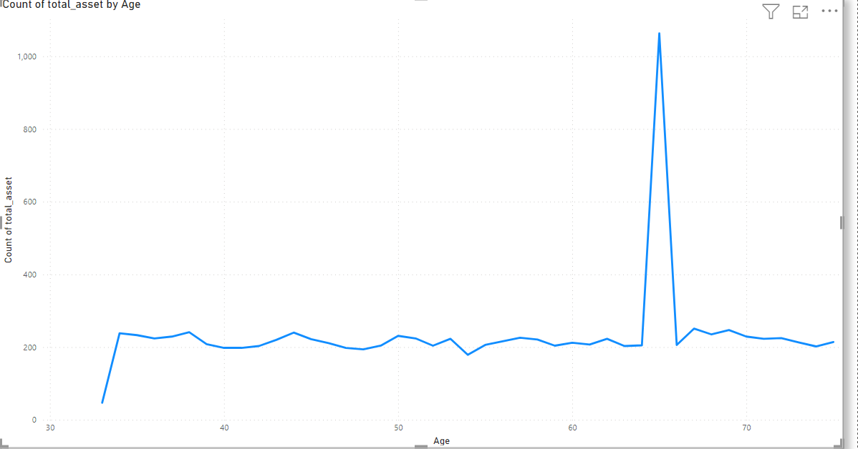
Statistician Wizard

Slide 19

Wealth Wizard's Women Empowerment Segment
We chose this segment because we want to help females who have less number of dependents.
We know that this segment is lesser spoken about which eventually carries lot of groundwork but will eventually open lot of opportunities for us.
We want to offer these customers solutions that can help them achieve their financial goals while empowering them and supporting them .
" We will help you achieve your financial goals with confidence and empowerment because we respect your choices and aspirations "
Mission Statement :
To provide financial solutions that are customized, flexible, and supportive for females who have less dependents.
Target Segment :
Gender: Female
Number of Dependents: 0, 1
Medium Risk Takers

Slide 20
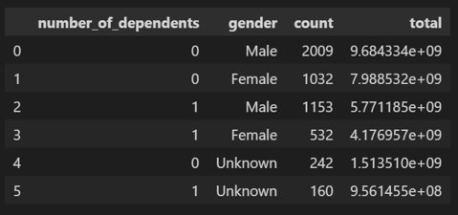
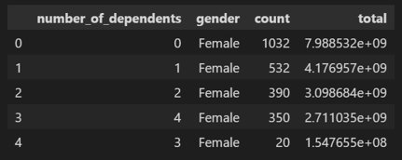
Statistician Wizard

Slide 21

Wealth Wizard's Early Bird Segment
We chose this segment because we want to help young customers who are high risk takers.
We know that these customers have different interests and aspirations than other young customers who are low or moderate risk takers or other customers who are older.
We want to offer these customers solutions that can help them pursue their dreams while maximizing their returns and taking advantage of the market opportunities and the biggest asset they have in the form of Time.
" Pursue your dreams with passion and performance because you have the biggest asset TIME "
Mission Statement :
To provide financial solutions that are dynamic, innovative, and rewarding for young customers who are high risk takers.
Target Segment :
Age range: 30 – 45 years
High Risk Takers

Slide 22
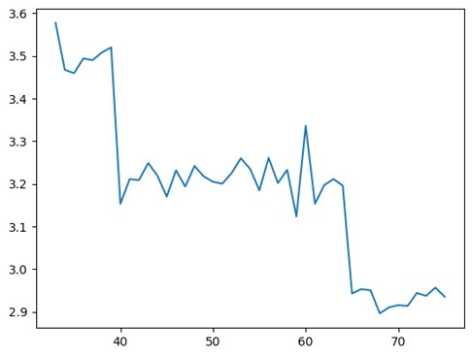
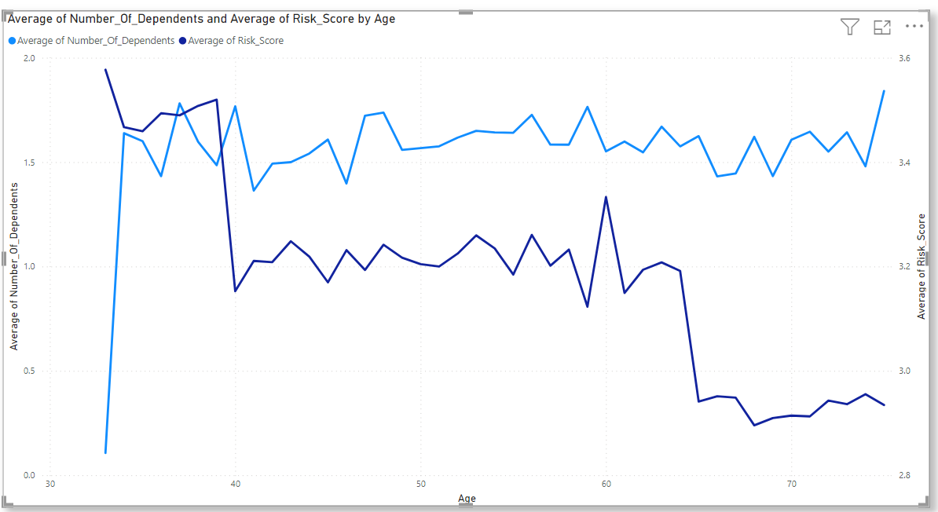
Statistician Wizard

Slide 23

Wealth Wizard's Premium Wealth Maximizer Segment
" Leverage your wealth with expertise, trust and excellence with premium valued services"
Mission Statement :
To provide financial solutions that are premium, diversified and effective for customers who live in areas with maximum asset and population with average to high risk tolerance.
Target Segment :
Geographical Factor: Areas with rich market in terms of asset.
Medium to Higher Risk Takers
We chose this segment because we want to help customers who live in areas with maximum asset and population with average to high risk tolerance.
We know that these customers have different behaviors and preferences than other customers who live in areas with less asset and population or with low risk tolerance.
We want to offer these customers premium services and solutions that can help them leverage their wealth and location while diversifying their portfolio and managing their risks.

Slide 24
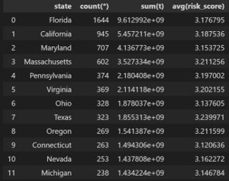
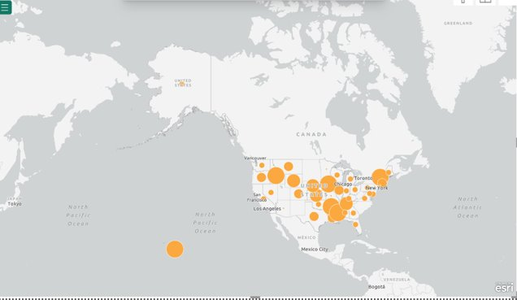
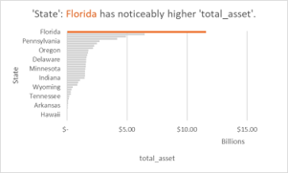
Statistician Wizard

Slide 25


Sentiment Analysis
Sentiment Analysis is a powerful NLP technique that uses ML to analyze the emotion tone, opinions expressed in text data
By analyzing the sentiment in the news headline, one can gauge market sentiment and make informed trade decisions.
Based on the prenotion that public perception can significantly impact stock prices.
Bag of Words and TF-IDF were used for tokenization the following models were used for train and test purposes:
RandomForest Classifier
Multinomial NB Classifier
PassiveAggressive Classifier
Step 1: Analyse and preprocess the Data
Step 2: Establish the logic and label the dataset based on increase or decrease in close price.
Step 3: Join the 2 dataset and remove Null values
Step 4: Test-Train Split
Step 5: Train and Test the ML Models
Step 6: Compare the accuracy metrics

Slide 26
Future Work
Analyse
Analyse the result of Sentiment Analysis to attempt to perform a predictive analysis.
Improve
Further improve model's accuracy using cross entropy, other Large models.
Come up
Come up with the Funds
Assign
Assign suitable funds to customer segmentation.

Slide 27
THANK YOU!!!

Slide 29
Leap case study team 3 – wealth wizards
Presented by:
Akanksha Raj
Deepthi N
Gyanadipta Mohanty
Vinayak Raj
Vishal Mishra

Slide 30
Wealth Wizards
"We conjure up the best solutions for your money"
Business goal:
To provide a range of portfolio management solutions that are customized, diversified, and effective for different segments of customers

Slide 31
Work Updates
Phase | Phase Detail | Tools Used | Completion Status
1 | Raw Data Analysis | SQL | Completed
2 | Data Analytics | Excel | Completed
3 | Data Exploration with Python | Python | Completed
4 | Statistical Programming | Python | Completed
5 | Data Visualization | PowerBI | Completed
6 | Analysis of Yahoo Finance Data | Python, PowerBI | Completed
7 | Data Integration | Talend | In Progress
8 | Data Deployment in the Cloud | MongoDB Atlas | Not yet started

Slide 32
Customer Segmentation

Slide 33
Wealth Wizard's Retirement Oriented Segment
"Secure your future and your retirement ambitions with us"
Mission Statement:
To provide retirement solutions that are tailored to the needs and risk profiles of customers who have multiple dependents
Target Segment :
Asset Objective: Retirement
Number of Dependents: 3+
Medium Risk Takers
We chose this segment because we want to help customers who have retirement objectives and have to support multiple dependents.
We know that these customers have different challenges and opportunities than other customers who have retirement objectives but have fewer or no dependents.
We also know that these customers have different risk profiles than other customers who have retirement objectives but are either low or high risk takers.
We want to offer these customers solutions that can help them achieve their retirement goals while balancing their risk appetite and their family obligations.

Slide 34
Wealth Wizard's Golden Peace Segment
"We will let you enjoy your golden years with peace of mind as we value your happiness and well-being "
Mission Statement:
To provide living solutions that are safe, stable, and suitable for customers who are into the old age group and are married.
Target Segment :
Marital Status: Married
Age Range: 60 – 70 years
Low Risk Takers
We chose this segment because we want to help customers who are in the old age group, are married, and are low risk takers.
We know that these customers have different needs and preferences than other customers who are in the old age group but are either single or high risk takers.
We want to offer these customers solutions that can help them enjoy their retirement years while preserving their capital and minimizing their losses.

Slide 35
Wealth Wizard's Early Bird Segment
We chose this segment because we want to help young customers who are high risk takers.
We know that these customers have different interests and aspirations than other young customers who are low or moderate risk takers or other customers who are older.
We want to offer these customers solutions that can help them pursue their dreams while maximizing their returns and taking advantage of the market opportunities and the biggest asset they have in the form of Time.
" Pursue your dreams with passion and performance because you have the biggest asset TIME "
Mission Statement :
To provide financial solutions that are dynamic, innovative, and rewarding for young customers who are high risk takers.
Target Segment :
Age range: 30 – 45 years
High Risk Takers

Slide 36
Wealth Wizard's Premium Wealth Maximizer Segment
" Leverage your wealth with expertise, trust and excellence with premium valued services"
Mission Statement :
To provide financial solutions that are premium, diversified and effective for customers who live in areas with maximum asset and population with average to high risk tolerance.
Target Segment :
Geographical Factor: Areas with rich market in terms of asset.
Medium to Higher Risk Takers
We chose this segment because we want to help customers who live in areas with maximum asset and population with average to high risk tolerance.
We know that these customers have different behaviors and preferences than other customers who live in areas with less asset and population or with low risk tolerance.
We want to offer these customers premium services and solutions that can help them leverage their wealth and location while diversifying their portfolio and managing their risks.

Slide 37
Wealth Wizard's Women Empowerment Segment
We chose this segment because we want to help females who have less number of dependents.
We know that this segment is lesser spoken about which eventually carries lot of groundwork but will eventually open lot of opportunities for us.
We want to offer these customers solutions that can help them achieve their financial goals while empowering them and supporting them .
" We will help you achieve your financial goals with confidence and empowerment because we respect your choices and aspirations "
Mission Statement :
To provide financial solutions that are customized, flexible, and supportive for females who have less dependents.
Target Segment :
Gender: Female
Number of Dependents: 0, 1,2
Medium Risk Takers

Slide 38
Fund Strategy
Investing at least 30% of assets in equity securities of companies that prioritize and advance women's leadership and development.
Such companies include those that, at the time of initial purchase,
Include a woman as a member of the senior management team
Are governed by a board for which women represent at least one third of all directors, or in the adviser's opinion have adopted policies designed to attract, retain and promote women
Employing sustainable investing exclusion criteria to avoid investments in issuers that are directly engaged in, and/or derive significant revenue from, certain industries which includes civilian semi-automatic firearms; tobacco production, or bonds issued against the proceeds of tobacco settlements etc

Slide 39

Fidelity Investments' Money FIT Women Study
Women require more support as well as financial education to be encouraged towards becoming more engaged in their finances over the next twelve months.
Women lack financial confidence, but underestimate their financial strengths.
Most women are confident they can balance a checkbook or manage the family budget without help, they are less confident regarding planning for their financial needs during retirement or selecting the right financial investments
However, women already possess strong financial habits and are taking strides to get more engaged.

Slide 40
Wealth Women Fund (WWOF)
 | BONDS | LARGE CAP | US MID CAP | US SMALL CAP | FOREIGN EX | EMERGING | COMMODITIES | MARKET ETF | Risk Score | Average Returns
LOW RISK | 49 | 12 | 11 | 7 | 0 | 7 | 0 | 14 | 2.09 | 6.012
MID RISK | 27 | 16 | 16 | 16 | 0 | 10 | 0 | 15 | 2.67 | 6.88
HIGH RISK | 15 | 15 | 18 | 28 | 0 | 15 | 0 | 9 | 3.19 | 7.49
** all units in percentage

Slide 41
Funds of other segments
​ | BONDS​ | MARKET ETF | LARGE CAP​ | US MID CAP​ | US SMALL CAP​ | FOREIGN EX​ | EMERGING​ | COMMODITIES​ | Risk Score​
Retirement Segment | 29 | 0 | 16 | 18 | 15 | 12 | 10 | 0 | 2.89
Gold and Peace Segment | 32 | 7 | 22 | 20 | 11 | 8 | 0 | 0 | 2.48
Early Bird Segment | 10 | 0 | 0 | 20 | 35 | 15 | 20 | 0 | 3.7
Premium Wealth Maximizer | 27 | 0 | 0 | 24 | 21 | 18 | 0 | 10 | 3.05

Slide 42

MACROECONOMICS ANALYSIS

Slide 43
Commodities related sectors, such as Oil & Gas industries and Metals & Mining are most sensitive to oil prices and the USD, since the two variables directly impact commodity prices. These sectors are also positively correlated to inflation expectations, as higher commodity prices tend to lift inflation expectations and increase the sectors’ profits.
Cyclical industries like Financials and Energy tend to move with 10-year yields, as higher 10-year yields generally point to strength in economic growth. Energy’s high sensitivity to 10-year yields is more likely driven by the high correlation between 10-year yields and oil prices since 2009.
Defensive sectors like Health Care and Consumer Staples tend to outperform amid lower oil prices, declining inflation expectations, and a stronger USD, resulting from a weaker economic outlook and risk-off sentiment.
Banks: Since banks borrow at short-term rates and lend at long-term rates, a steepening yield curve generally provides tailwinds for banks’ profits, while a flattening curve means headwinds. Under the bear steepening scenario, higher rates on both the long and short end of the curve indicate that tightening monetary policies are not expected to hinder positive growth prospects, which further support demand for credits and bank revenue growth.
Utilities and Real Estate: Low Treasury yields also make Utilities’ and Real Estate’s high dividend income more attractive to investors. Lower yields also generally point to a weaker economic growth outlook and risk-off market sentiment, which favor high dividend defensive stocks in Utilities and Real Estate.
Communication Services and Tech have negative correlation to 10-year yields that can be explained by their growth-oriented, long-duration profile, as higher risk-free rates weigh more on growth stock valuations.

Slide 44
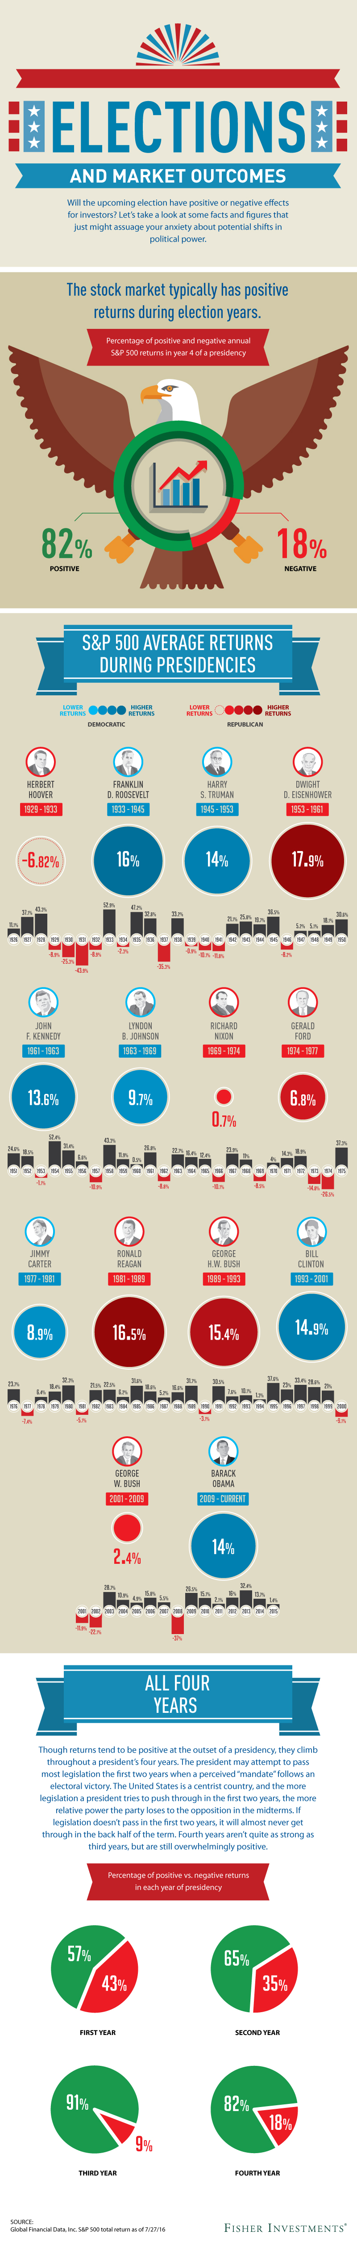

Slide 46
Year of Term | Positive Returns | Negative Returns
1 | 57% | 43%
2 | 65% | 35%
3 | 91% | 9%
4 | 82% | 18%

Slide 47
Monte Carlo Simulation

Slide 48
Data Visualization

Slide 49
Exploring Yahoo Finance Data using Web Services

Slide 50
Data Integration using Talend

Slide 51
Future Work
Data Integration
Gain more insights using Talend
Data Deployment
Use MongoDB Atlas for data deployment in Cloud

Slide 52
Q&A

